Slide 1
UNIQ+ R COURSE
Monday 8th July
Oxford 2024

Slide 2
MORNING
Superhero dataset
Work on your own: research questions
Handling missing values
Merging data.frames
Basic statistics
AFTERNOON
Plotting with R
Plotting with ggplot2
Exercise and discussion

Slide 3
HERO DATASET
Thursday 8th July

Slide 4
Superhero dataset
Let´s practice what we learnt yesterday!
Explore data
What type of variables we have?
Do they make sense?
Is there any missing data?
Use what you learnt yesterday
Brainstorm some scientific questions
Try to answer them!

Slide 5

Let´s practice!
Image by lucabravo on Freepik

Slide 6
HANDLING MISSING VALUES
Thursday 8th July

Slide 7
Nas/NaN
NA/NaN are used to define missing values.
This happen when there is no data or insensible or impossible arithmetic operations are tried.
Finding/test missing data: is.na()/is.nan()
Filtering missing data:
na.omit()- rules out any rows containing missing value
Careful! Sometimes missing data comes in other forms as “-” , 0 or “not specified”. These probably need recoding.

Slide 8
Let´s practice!
Image by lucabravo on Freepik

Slide 9
Merging data.frames
Monday 8th July

Slide 10
Merging data.frames
Joining two data.frames based on one or more columns - merge()
Columns
Columns
Rows
id
age
pet_ins
Rows
id
pet
al
28
T
lee
dog
al
28
T
lee
dog
1
1
2
pat
23
F
pat
23
F
pat
hamster
pat
hamster
2
3
ed
13
T
al
mouse
ed
13
T
al
mouse
3
4
lee
6
T
4
ed
cat
lee
6
T
ed
cat

Slide 11
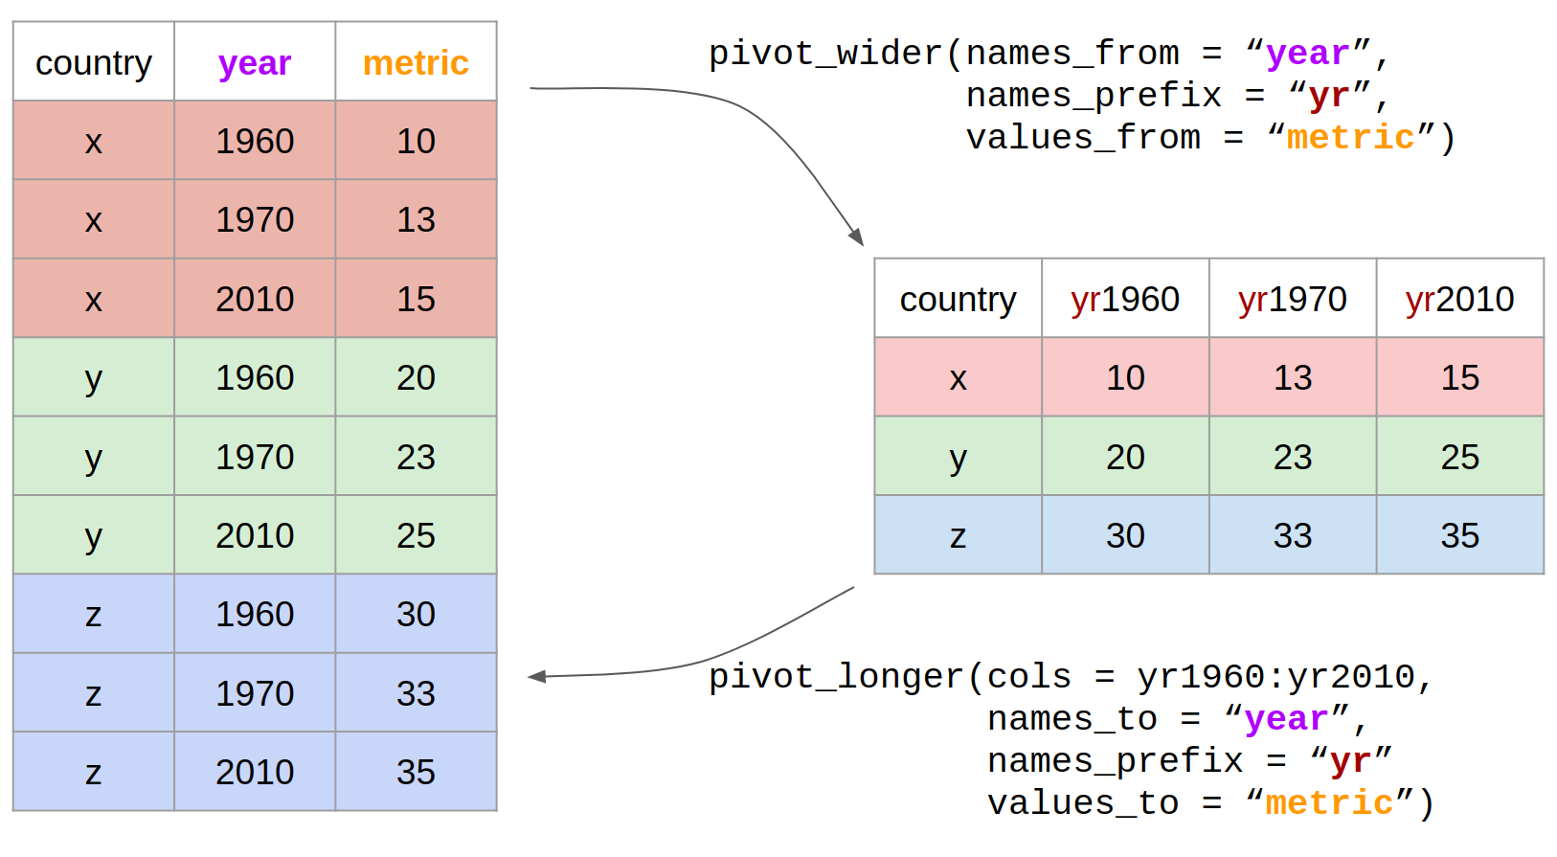
Reshaping
Wide to long with pivot_longer()
Long to wide with pivot_wider()

Slide 12
Basic statistics
Monday 8th July

Slide 13
Basic statistics
Correlation – relationship between two continuous variables
cor.test()
Comparison of means
t.test()
wilcox.test()
Random number generation
rnorm()
sample()
set.seed()

Slide 14
DATA VISUALISATION
Thursday 8th July

Slide 15
Plotting with R
Easy to visualize data
What do we want to visualize?:
Do we need detailed info (see every data point) or just mean/median or distribution?
What type of data we have?
Scale?
Colours?
Legend?
Important to understand basic concepts (e.g., how to call variables of df)

Slide 16
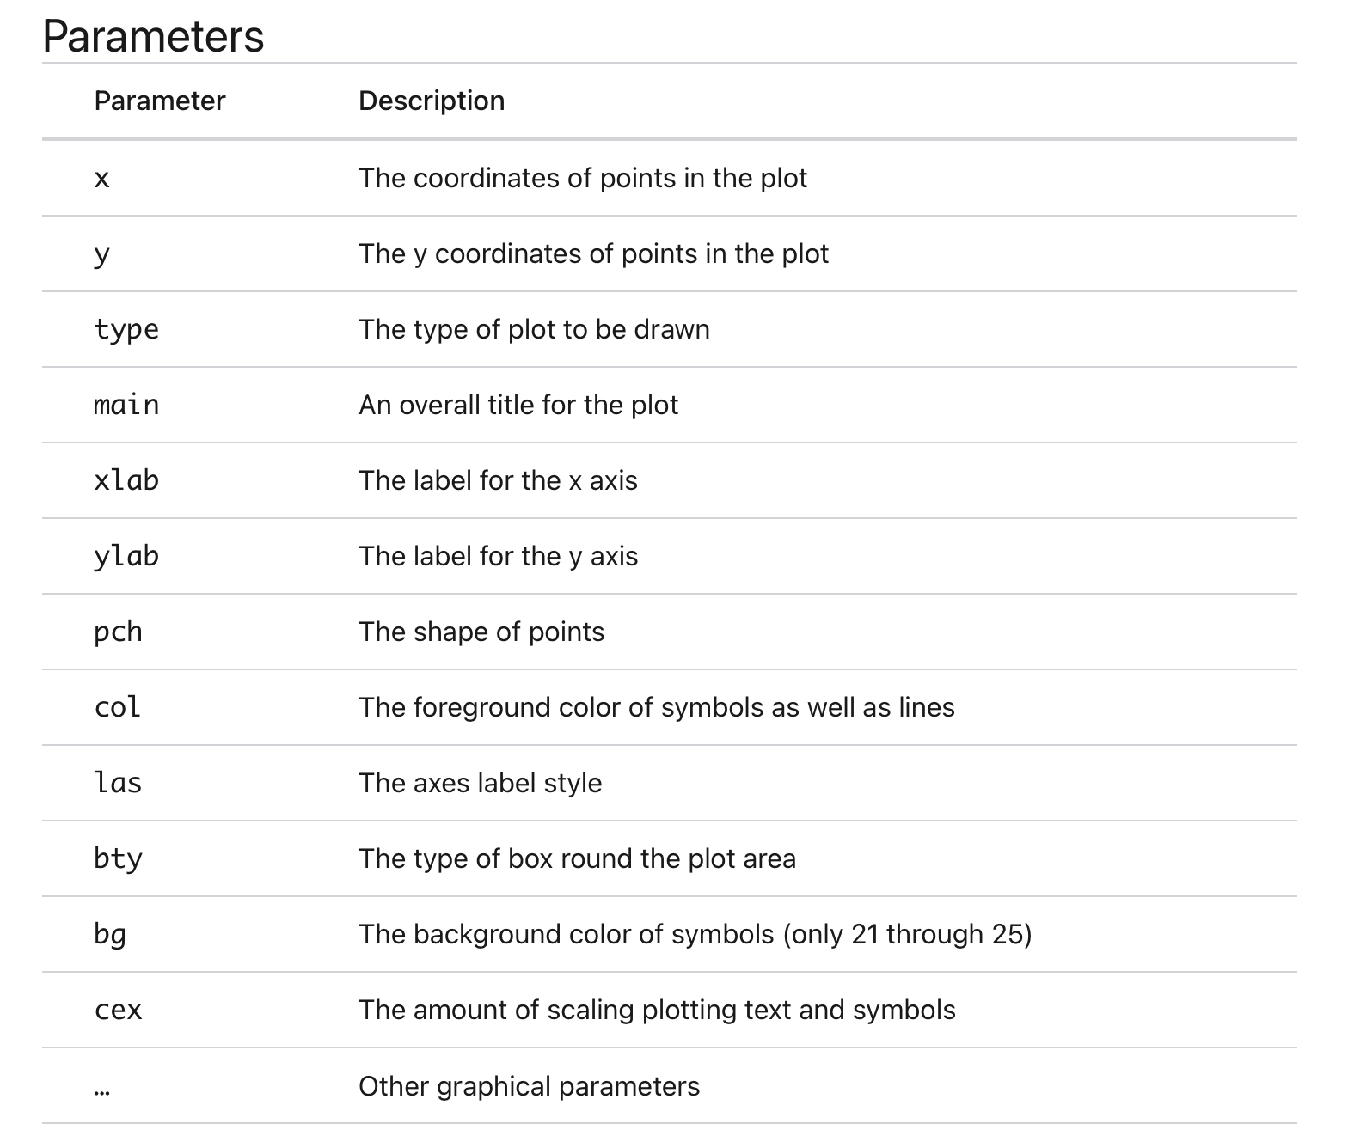
Basic R plotting
Function plot() is not a single defined function. Generic function. The exact function being called will depend on the parameters used.

Slide 17
Basic R plotting
Type of graph | Command
Histogram | hist()
Boxplot | boxplot()
Scatterplot | plot()
Pairwise correlation | pairs()
Arguments matter…
Arguments | Plot
plot(x,y) | Scatterplot of x and y numeric vectors
plot(factor) | Barplot of the factor
plot(factor,y) | Boxplot of the numeric vector and the levels of the factor
plot(df) | Correlation plot of all dataframe columns

Slide 18
Categorical data / factors
Data that can be separated into categories. e.g., race, sex or educational level.
We can convert data using as.factor().

Slide 19
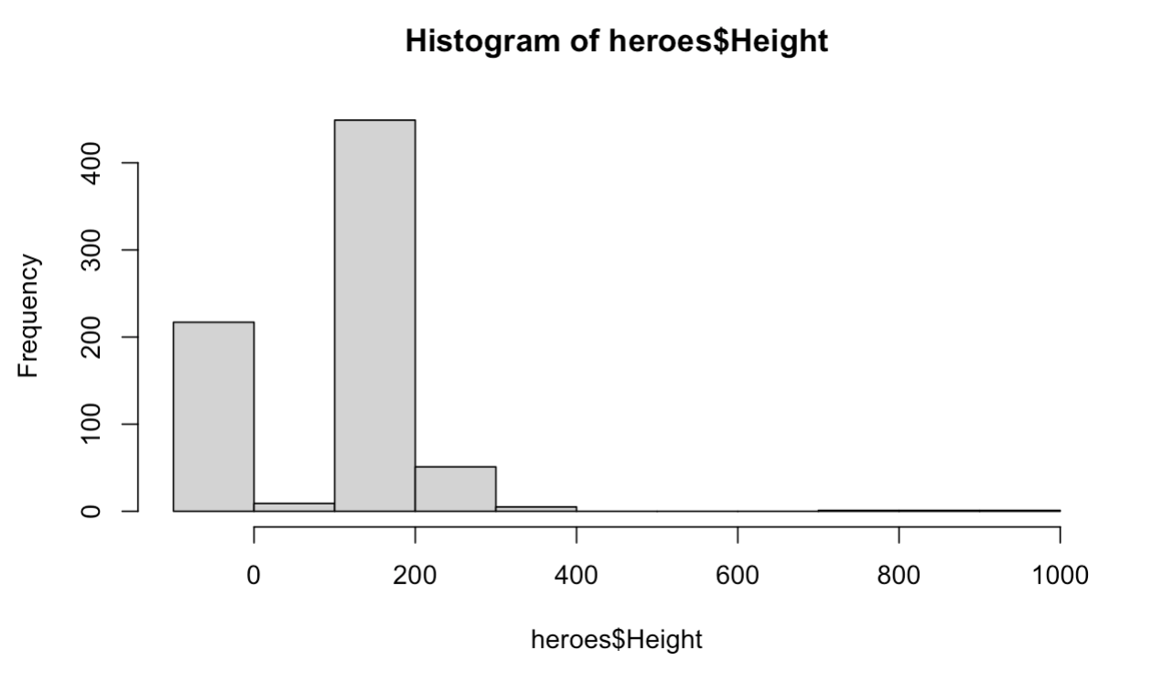
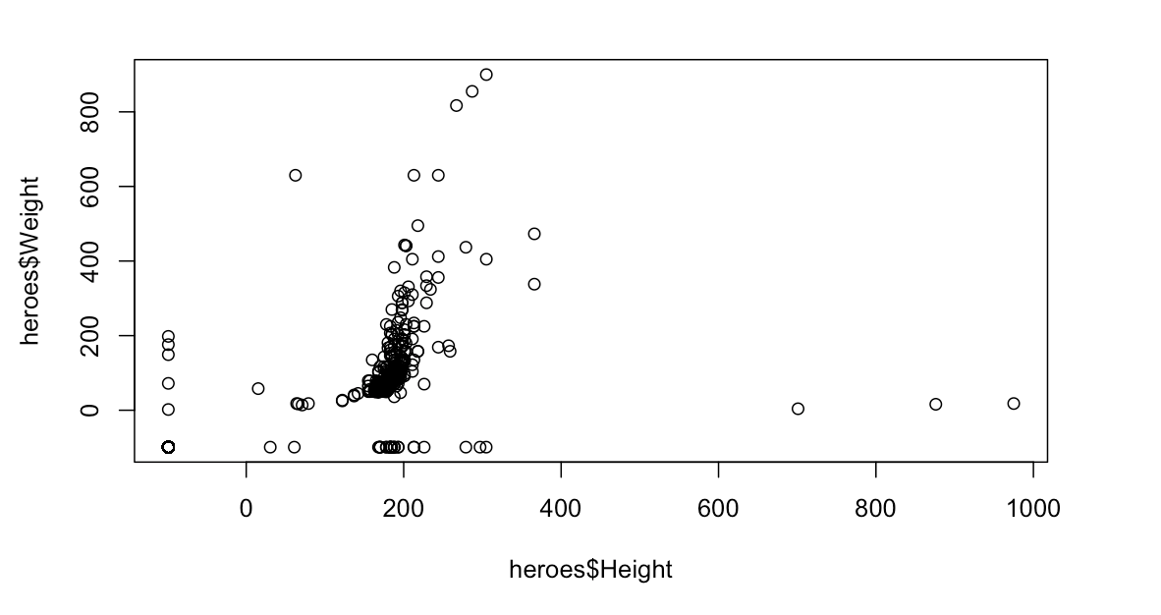
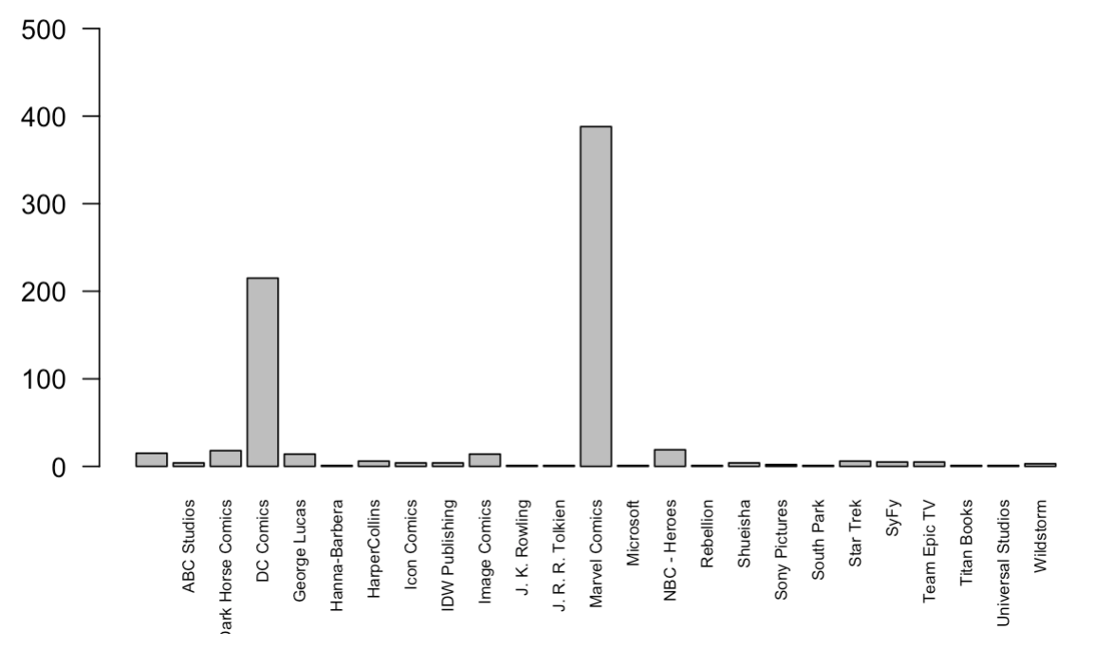
Basic R plotting
hist(heroes$Height)
plot(heroes$Height, heroes$Weight)
plot(heroes$Publisher)

Slide 20
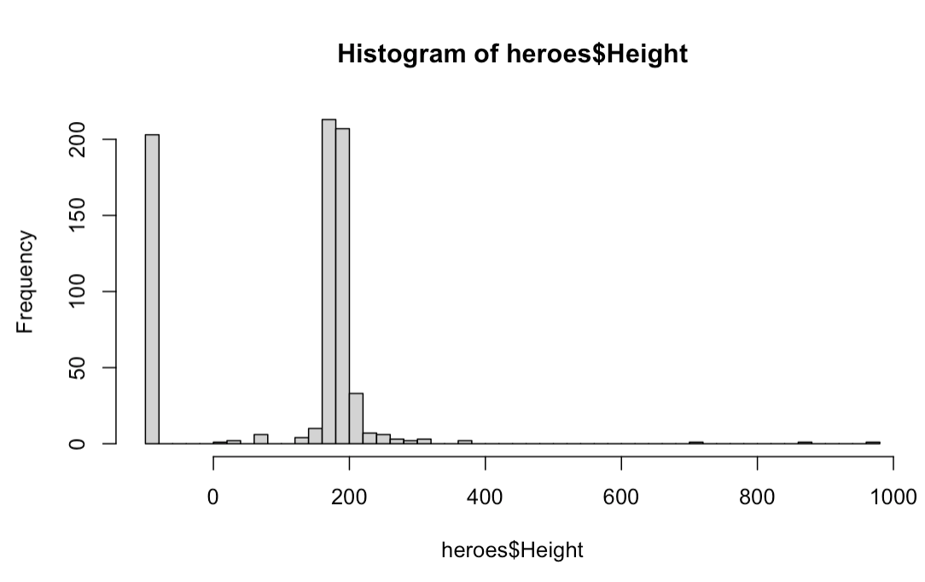
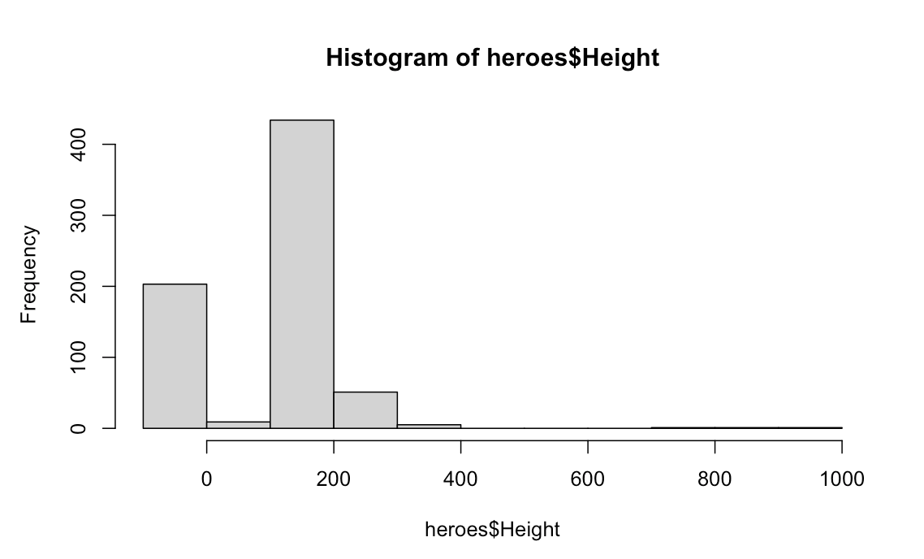
Basic R plotting: histogram
hist(heroes$Height)
hist(heroes$Height, breaks=50)

Slide 21
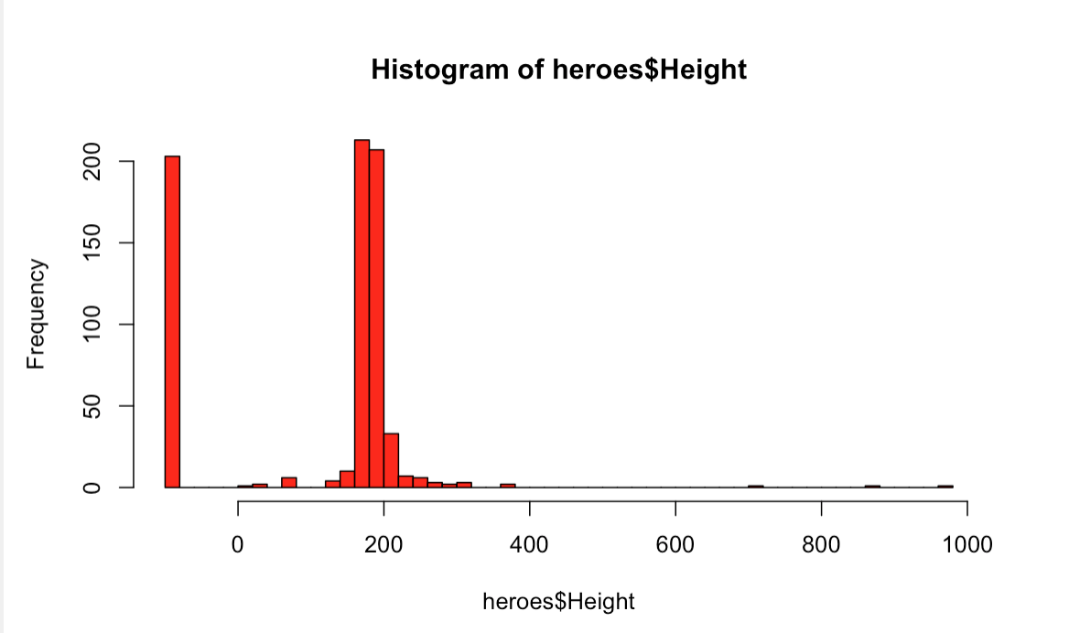
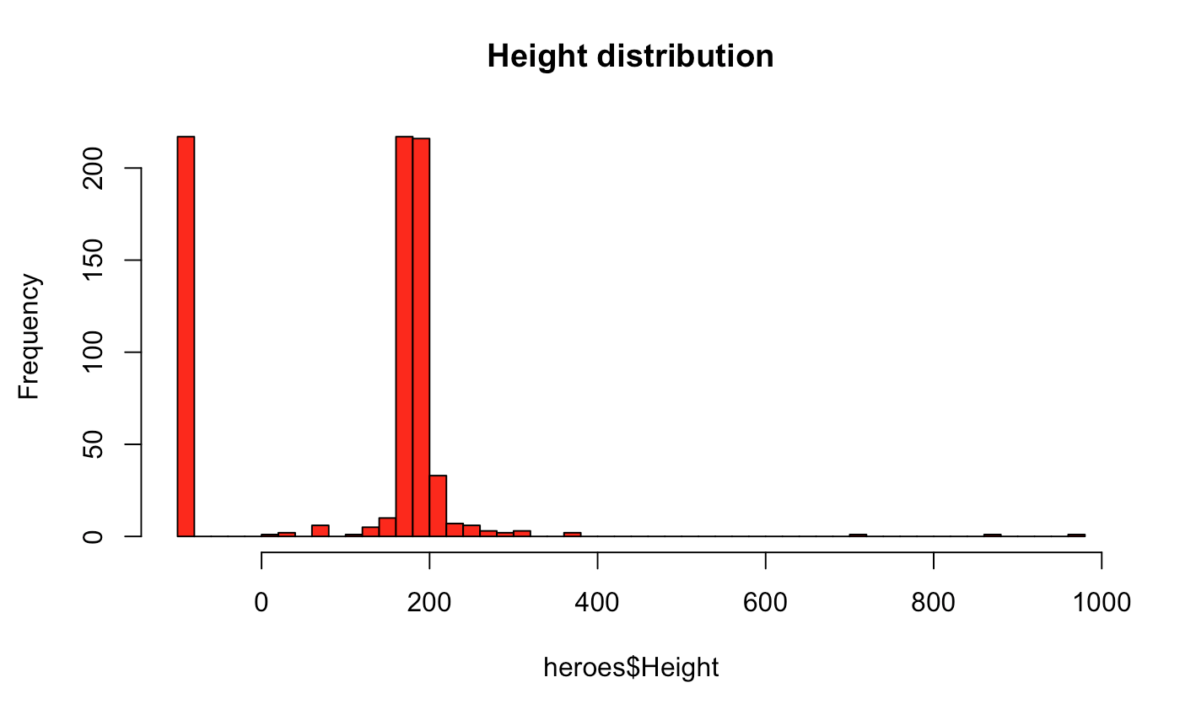
Basic R plotting: histogram
hist(heroes$Height, breaks=50, col= “red”)
hist(heroes$Height, breaks=50, col= “red”, main = ”Height distribution”)

Slide 22
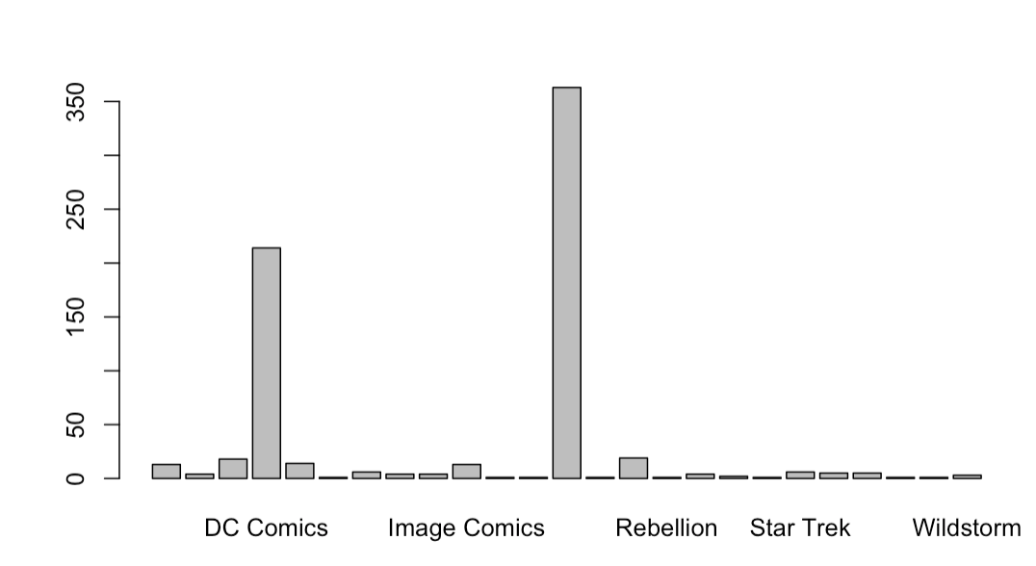
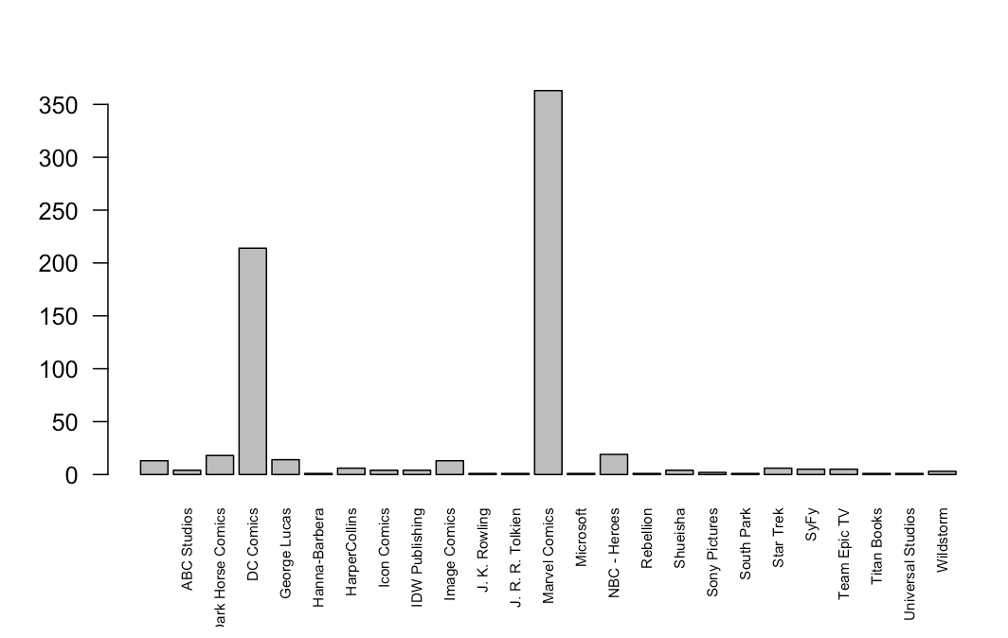
Basic R plotting: barplots
plot(heroes$Publisher)
plot(heroes$Publisher, las=2)

Slide 23
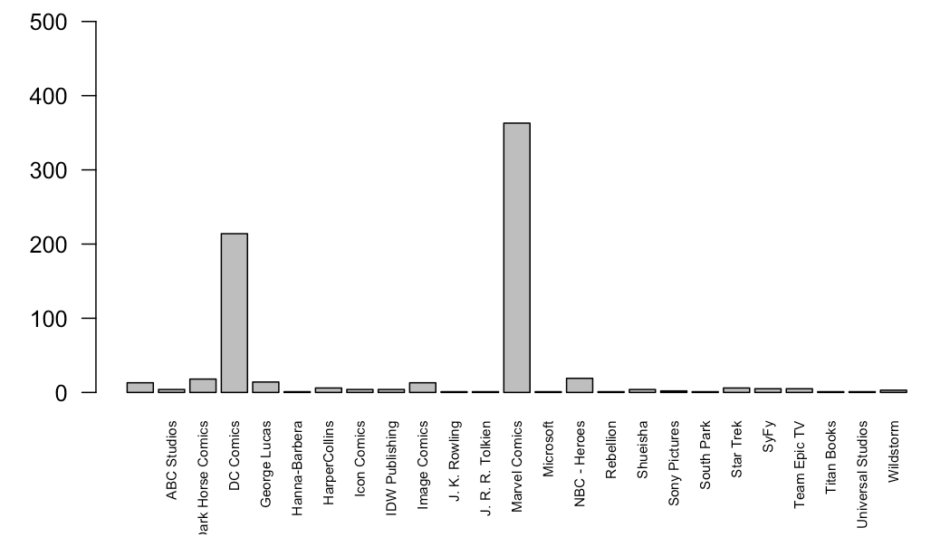
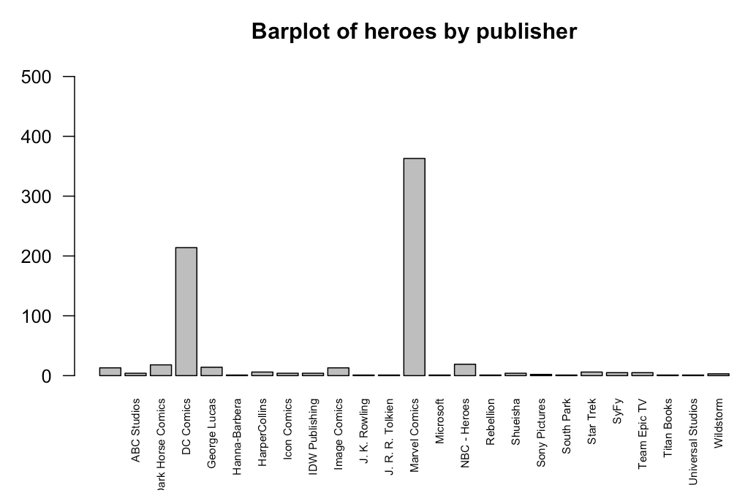
Basic R plotting: barplots
plot(heroes$Publisher, las=2, ylim= = c(0,500))
plot(heroes$Publisher, las=2, ylim= c(0,500), main = "Barplot of heroes by publisher")
TAKE HOME MESSAGE:
YOU NEED TO KNOW ALL YOU CAN DO BUT YOU DON´T NEED TO KNOW ALL

Slide 24
Basic R plotting: scatterplot
plot(heroes$Height, heroes$Weight)

Slide 25
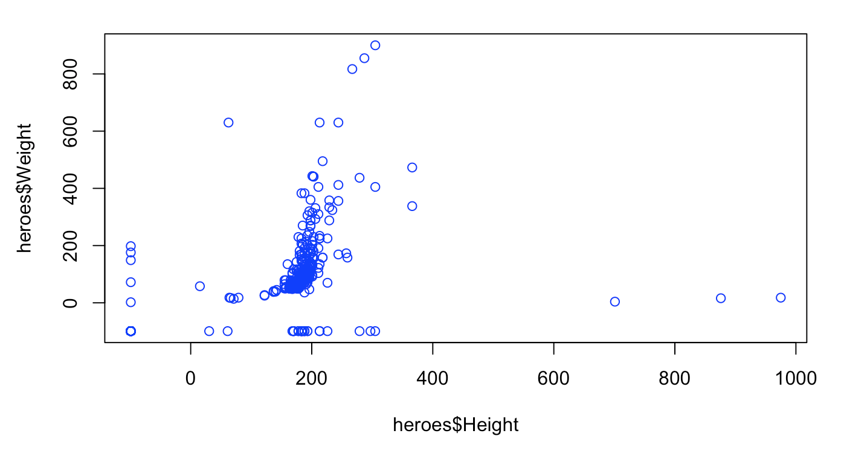
Basic R plotting: scatterplot
plot(heroes$Height, heroes$Weight, col=“blue”)

Slide 26
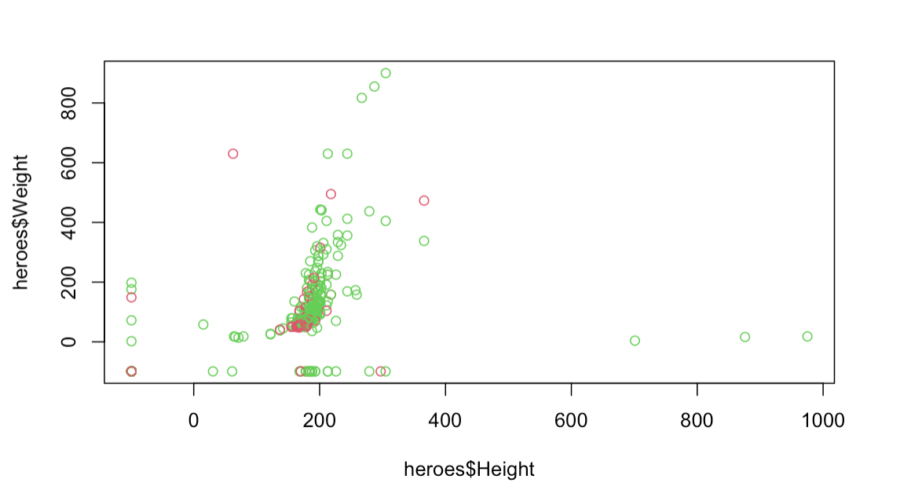
Basic R plotting: scatterplot
plot(heroes$Height, heroes$Weight, col=heroes$Gender)

Slide 27
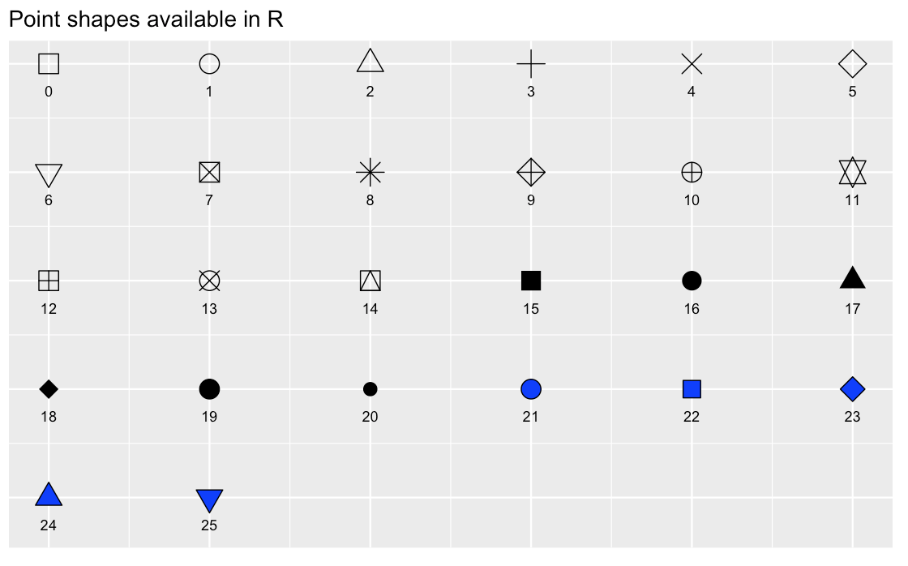
Basic R plotting: scatterplot
plot(x,y)
plot(x,y
xlab =(), #x title
ylab =(), #y title
xlim = c(), #x axis
ylim = c(), #y axis
pch = (), #plotting symbol
las =()#axis label angle
cex.axis =() #axis label magnification/reduction
)

Slide 28
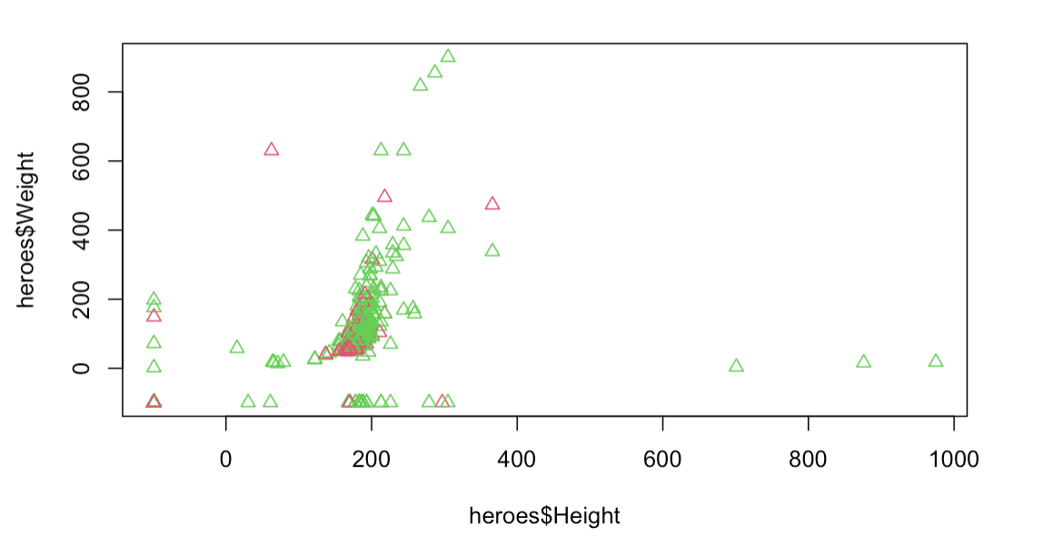
Basic R plotting: scatterplot
plot(heroes$Height, heroes$Weight, col=heroes$Gender, pch=24)

Slide 29
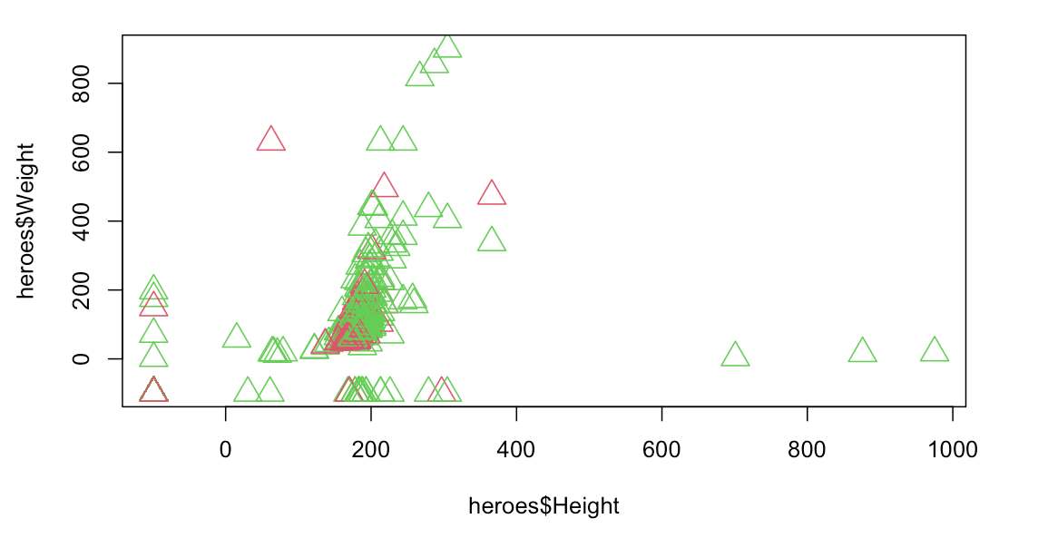
Basic R plotting: scatterplot
plot(heroes$Height, heroes$Weight, col=heroes$Gender, pch=24, cex=2)

Slide 30
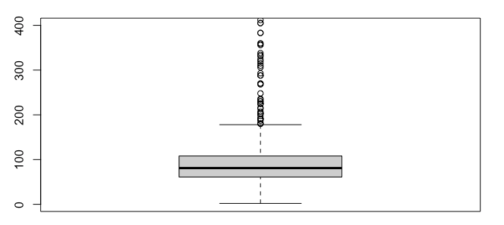
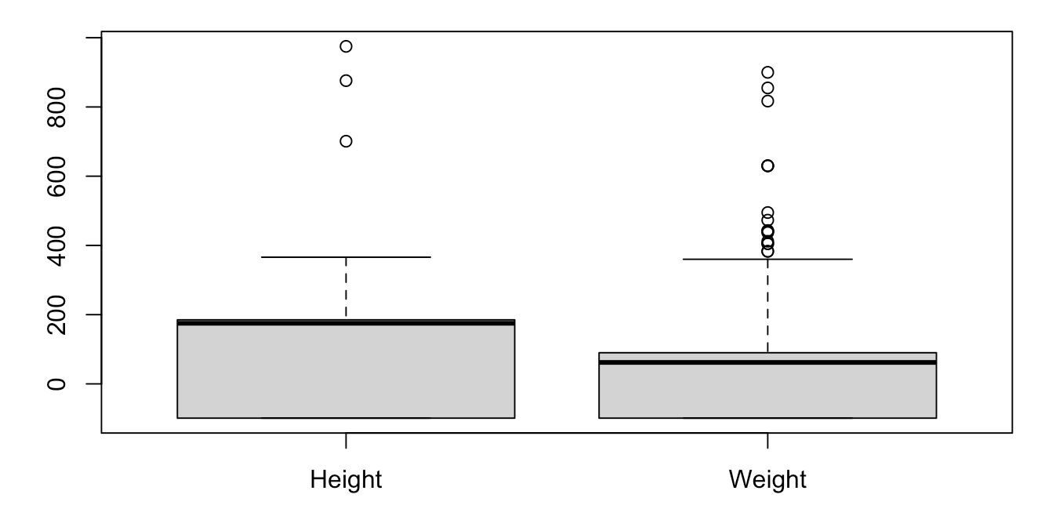
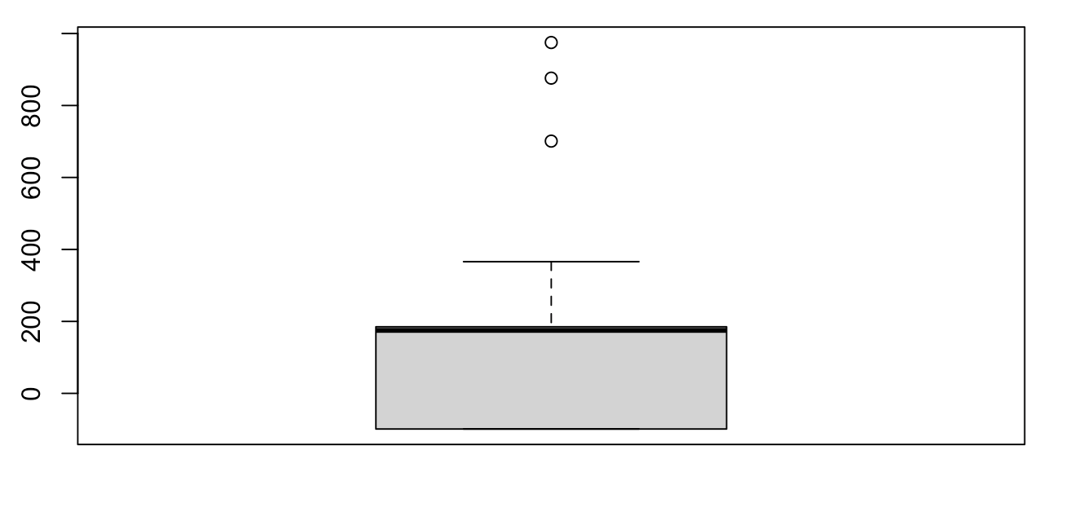
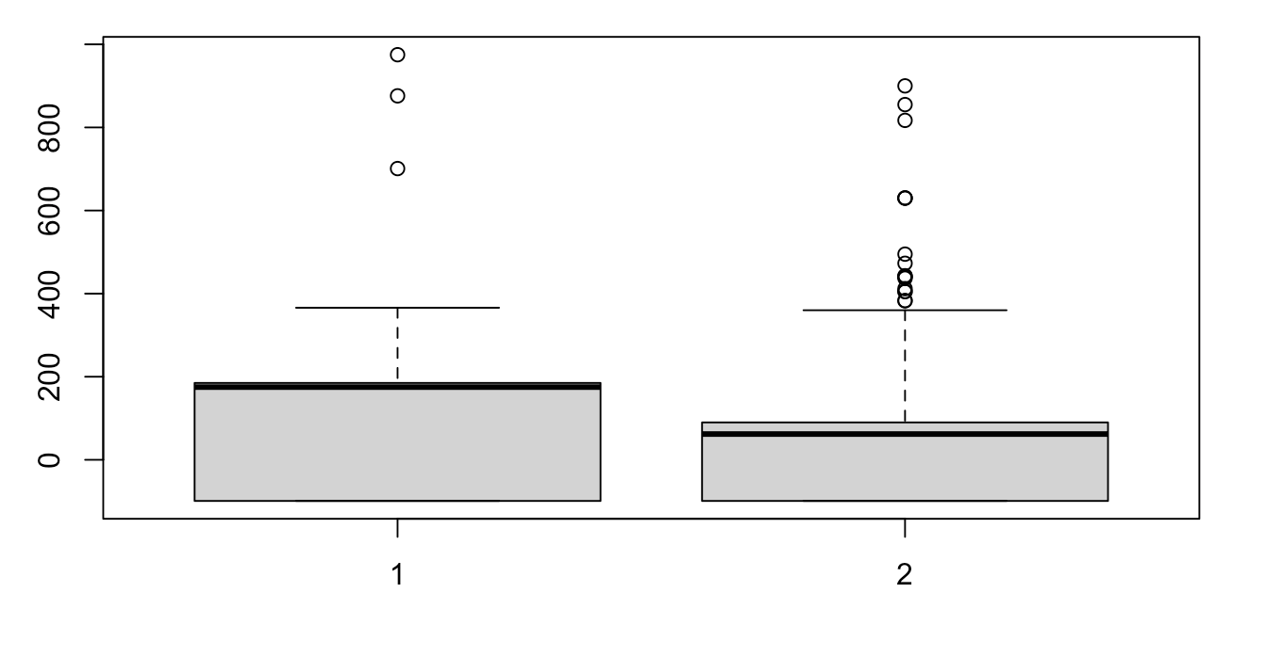
Basic R plotting: boxplots
boxplot(heroes$Height)
boxplot(heroes$Height, heroes$Weight)
boxplot(heroes$Height,heroes$Weight, names=c("Height", "Weight"))

Slide 31
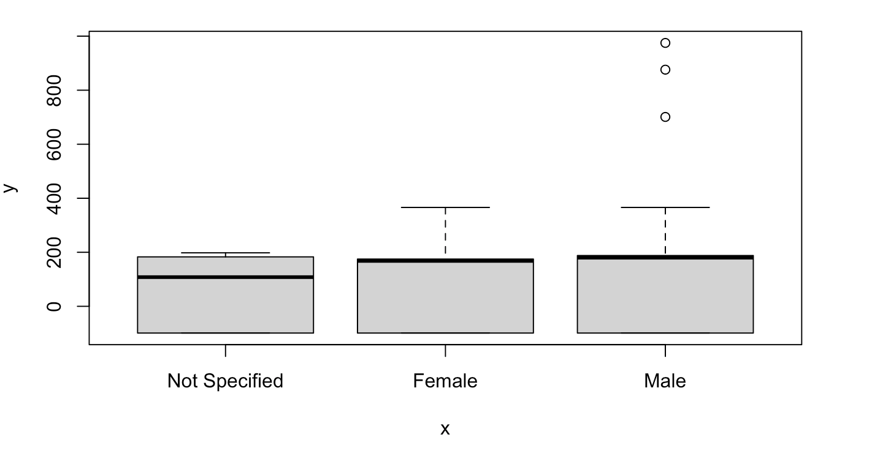
Basic R plotting: boxplots
plot(heroes$Gender, heroes$Height)

Slide 32
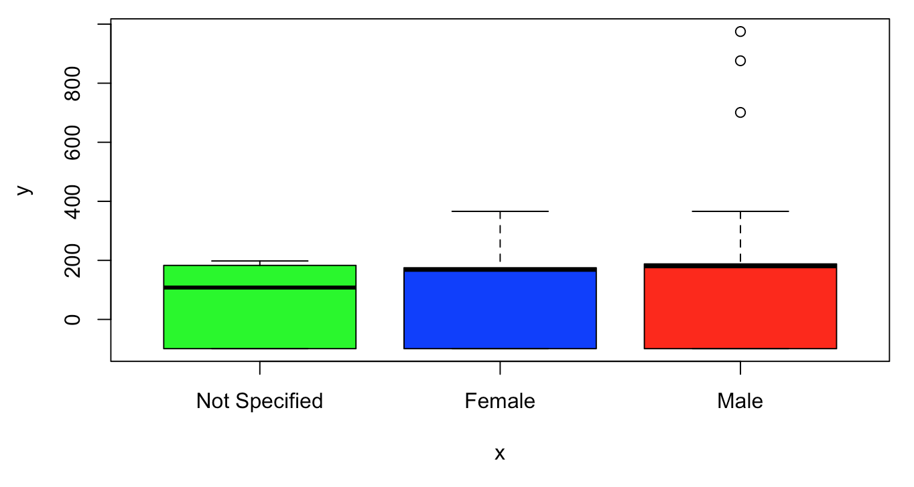
Basic R plotting: boxplots
plot(heroes$Gender, heroes$Height, col=c("green","blue", "red"))

Slide 33
Basic R plotting: add legend()
plot(heroes$Height, heroes$Weight, col=heroes$Gender, pch=24, cex=2)

Slide 34
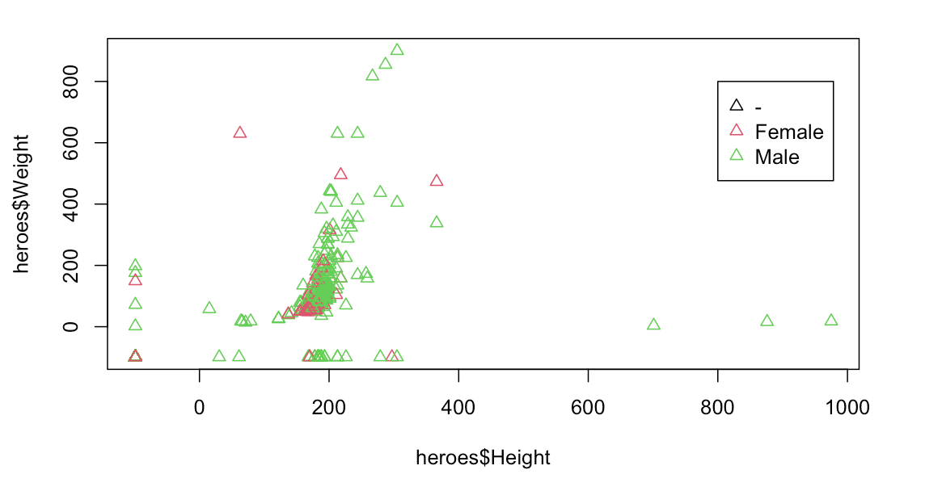
Basic R plotting: add legend()
plot(heroes$Height, heroes$Weight, col=heroes$Gender, pch=24, cex=2)
legend(x=800, y=800, legend = levels(heroes$Gender), col=c(1:3), pch= 24)

Slide 35
How to visualize plots
Directly in Rstudio
For quick visualization and exploratory analysis
Depending on type of file used can be seen in the output directly on the source pane (Rmarkdown) or in the output window.
Export and save as pdf, png...
Functions pdf(), png(), bmp(), jpeg()
dev.off

Slide 36
Basic R plotting: help
help() / ?
The R Graph Gallery
If you don’t know something: google it!

Slide 37
Let´s practice!
Image by lucabravo on Freepik

Slide 38
Limitations base graphics
You could do anything you require in base graphics, BUT:
Some common actions are not that straightforward
Legends
Error bars
Formatting axes
More complex graphs are time-consuming
So the recommendation is:
Base R graphs for quick and basic exploratory analysis
ggplot2 best for anything else
So…. What is ggplot2?

Slide 39
Plotting with ggplot2
Plotting package. It is part of the tidyverse package so it can be installed by:
install.packages(“tidyverse”):collection of R packages designed for data science that includes ggplot2.
install.packages(“ggplot2”)
Remember to always load package with library(ggplot2)

Slide 40
Plotting with ggplot2: all about layers
Decomposes graphics into layers:
Data
Mapping
Statistics
Scales
Geometries
…
ggplot()
Most basic/important layers: data, mapping (aesthetics) & geometry.
data
mapping
Informs to ggplot2 to understand the dataset (where to grab de info from)
Links variables in data to graphical properties in the geometry
geometry
How to interpret aesthetics
Determines mainly the plot type
Theme
Geometry
ggplot(data = …, mapping = aes()) + geom_function()
Mapping
Data

Slide 41

Plotting with ggplot2
install.packages(“ggplot2”)
library(ggplot2)
ggplot()

Slide 42
Plotting with ggplot2
ggplot function needs information about: the data (data=…), aesthetics(aes=….) and geometry.
ggplot()

Slide 43
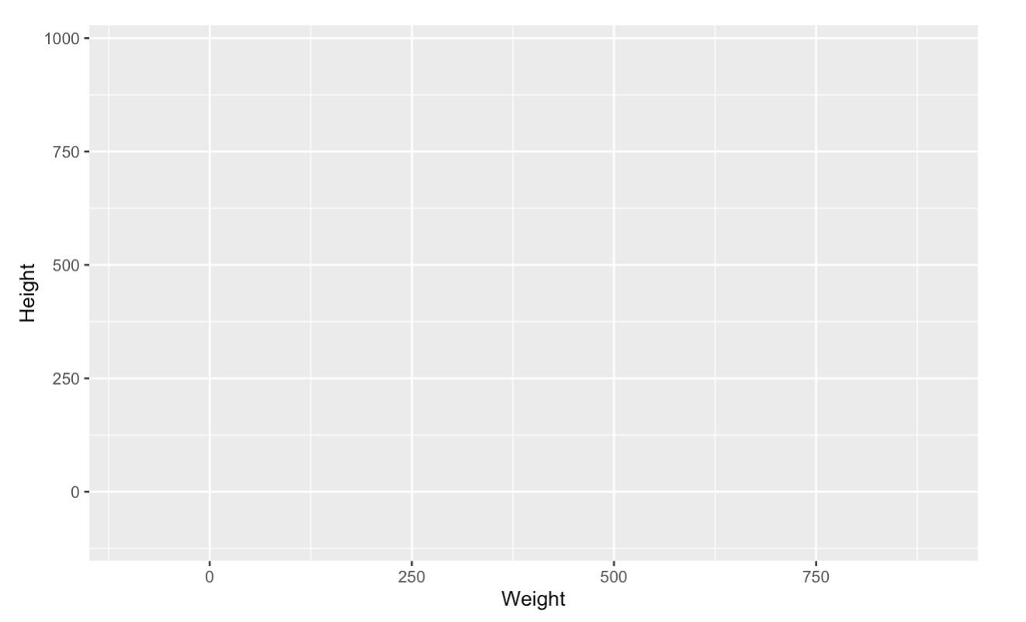
Plotting with ggplot2: data and mapping
ggplot(data = heroes, mapping = aes(Weight,Height))
We haven’t told still to ggplot how to plot data!

Slide 44
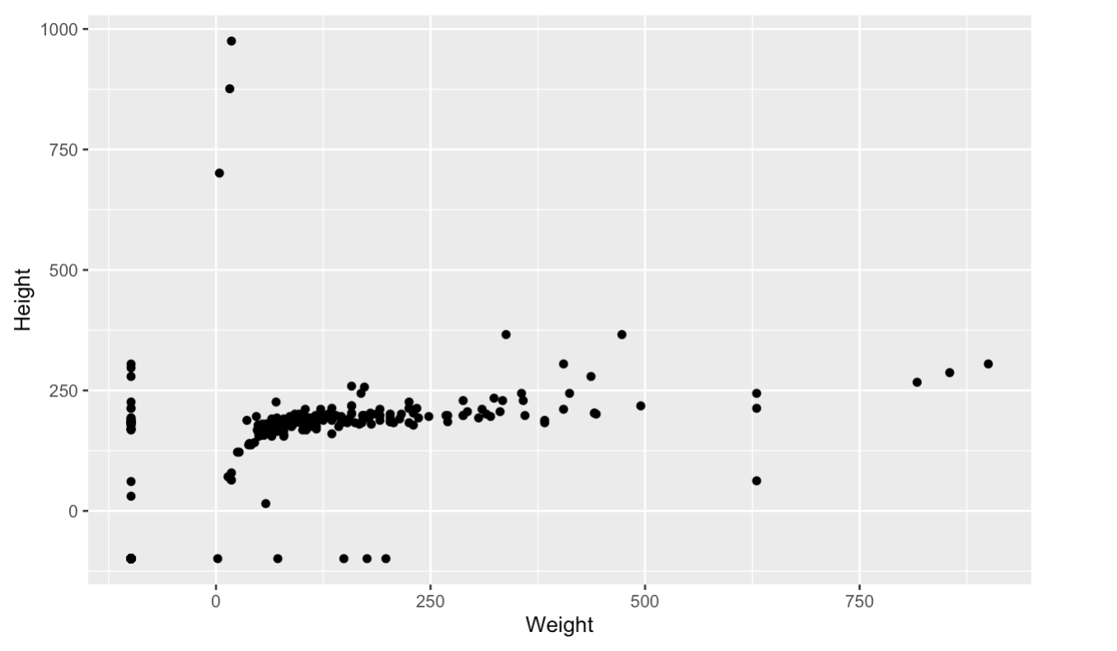
Plotting with ggplot2: geometry
Data to display
ggplot(data = heroes, mapping = aes(Weight,Height))+
geom_point()
Variables to display
Geometry info will say how to display the data
How to display

Slide 45
Plotting with ggplot2: geometry
ggplot(data = heroes)+
geom_point(mapping = aes(Weight,Height))
In this case the global data is defined but the mapping is specific to the layer geom and will not be inherited to the following layers.

Slide 46
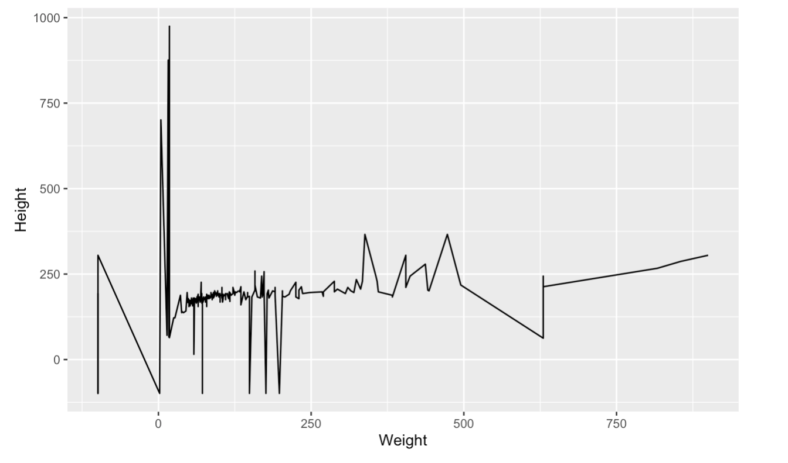
Plotting with ggplot2: geometry
New layer
ggplot(data = heroes, mapping = aes(Weight,Height))+
geom_line() # adding geometry will display data
Geometry info will say how to display the data

Slide 47
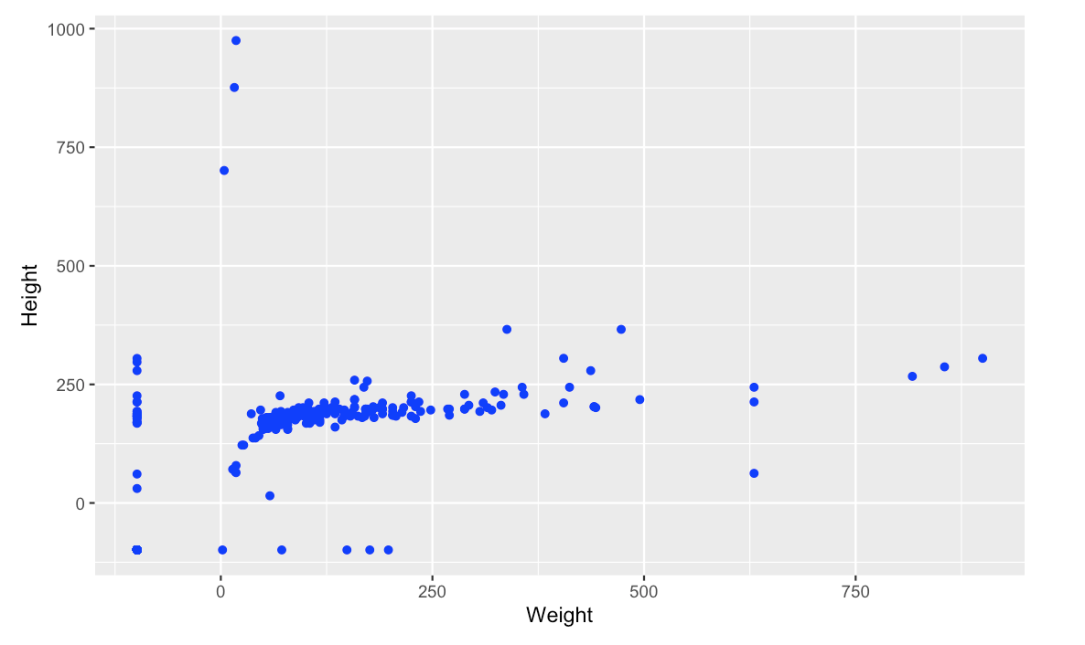
Plotting with ggplot2: geometry
Data to display
ggplot(data = heroes, mapping = aes(Weight,Height))+
geom_point(colour = ”Blue”))
Variables to display
How to display

Slide 48
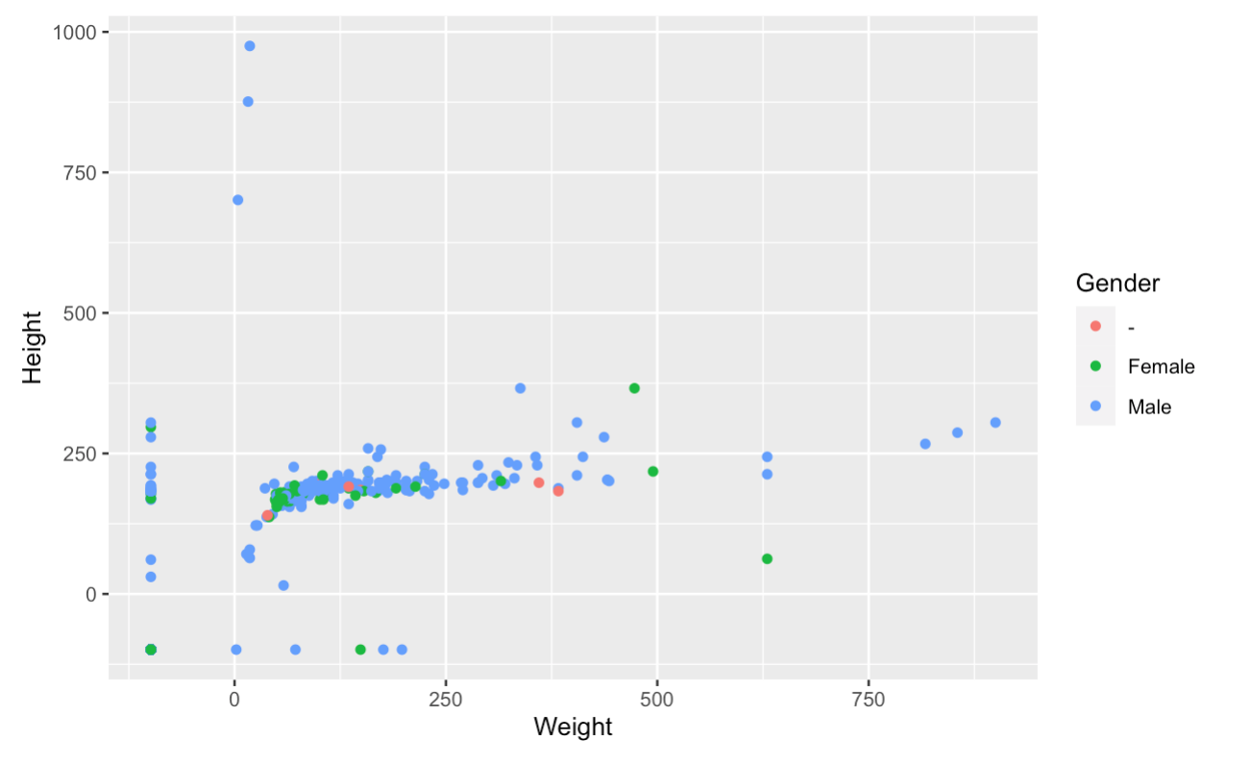
Plotting with ggplot2: geometry
ggplot(data = heroes, mapping = aes(Weight,Height))+
geom_point(aes(colour = Gender))
Automatic created legend

Slide 49
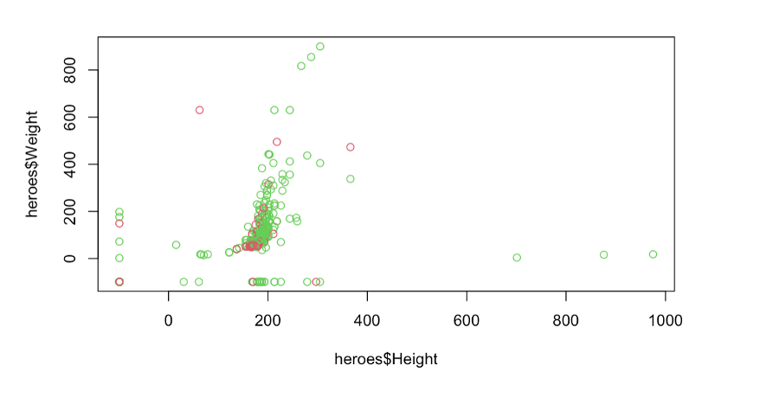
plot(heroes$Height, heroes$Weight, col=heroes$Gender)
ggplot(data = heroes, mapping = aes(Weight,Height))+
geom_point(aes(colour = Gender))

Slide 50
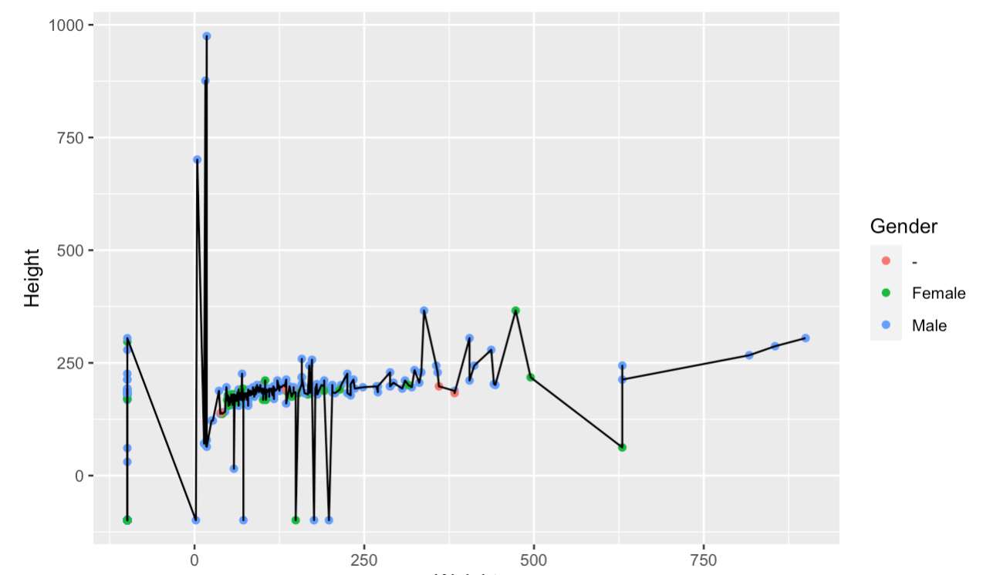
Plotting with ggplot2: geometry
New layer
ggplot(data = heroes, mapping = aes(Weight,Height))+
geom_point(aes(colour = Gender))+
geom_line()
New layer
Geometry info will say how to display the data. We can add several layers.

Slide 51
Plotting with ggplot2: geometry
New layer
ggplot(data = heroes, mapping = aes(Weight,Height))+
geom_point(aes(colour = Gender))+
geom_line()
New layer
No need to specify data and mapping
No need to specify data and mapping
ggplot(heroes, aes(Weight,Height)) +
geom_point(aes(colour = Gender)) +
geom_line()
Get help on Rstudio: look for geom_point in help

Slide 52
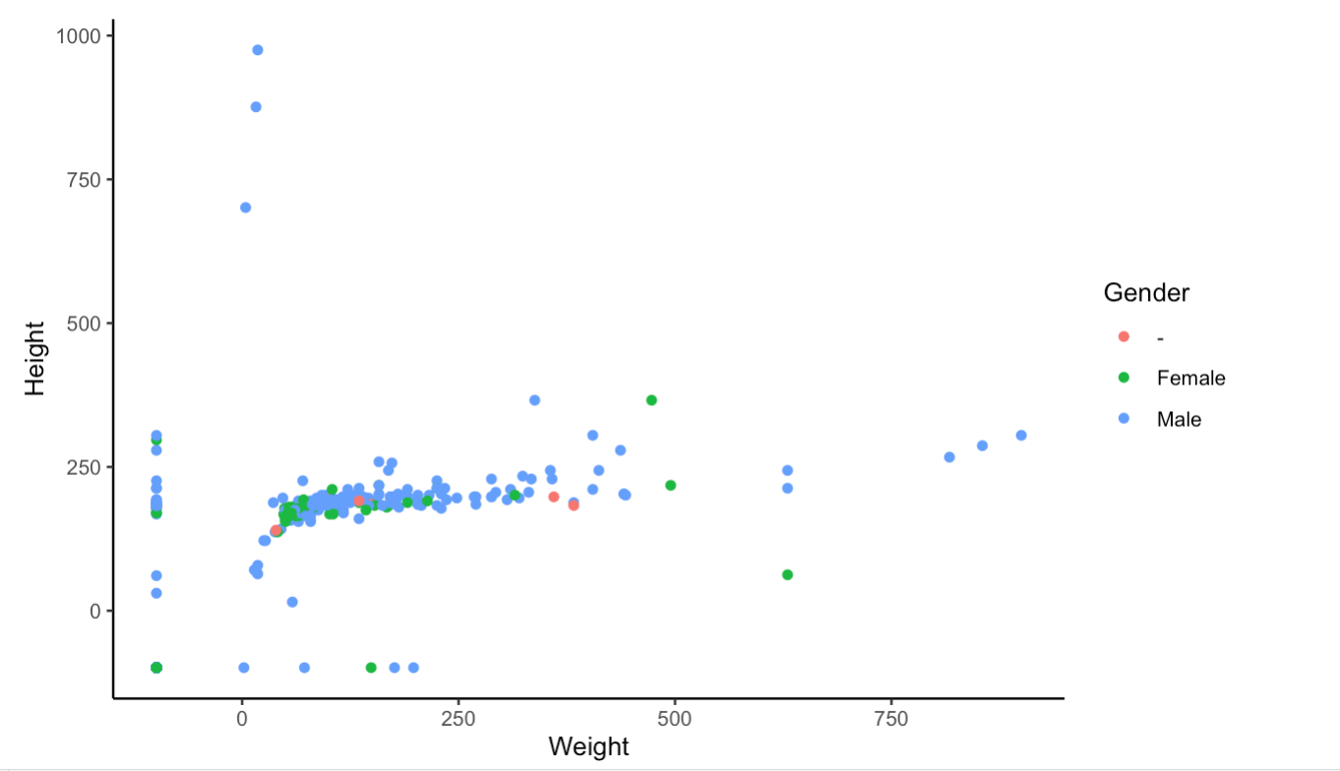
Plotting with ggplot2: themes
ggplot(data = heroes, mapping = aes(Weight,Height))+
geom_point(aes(colour = Gender))+
theme_classic()
Predefined themes that control general style

Slide 53
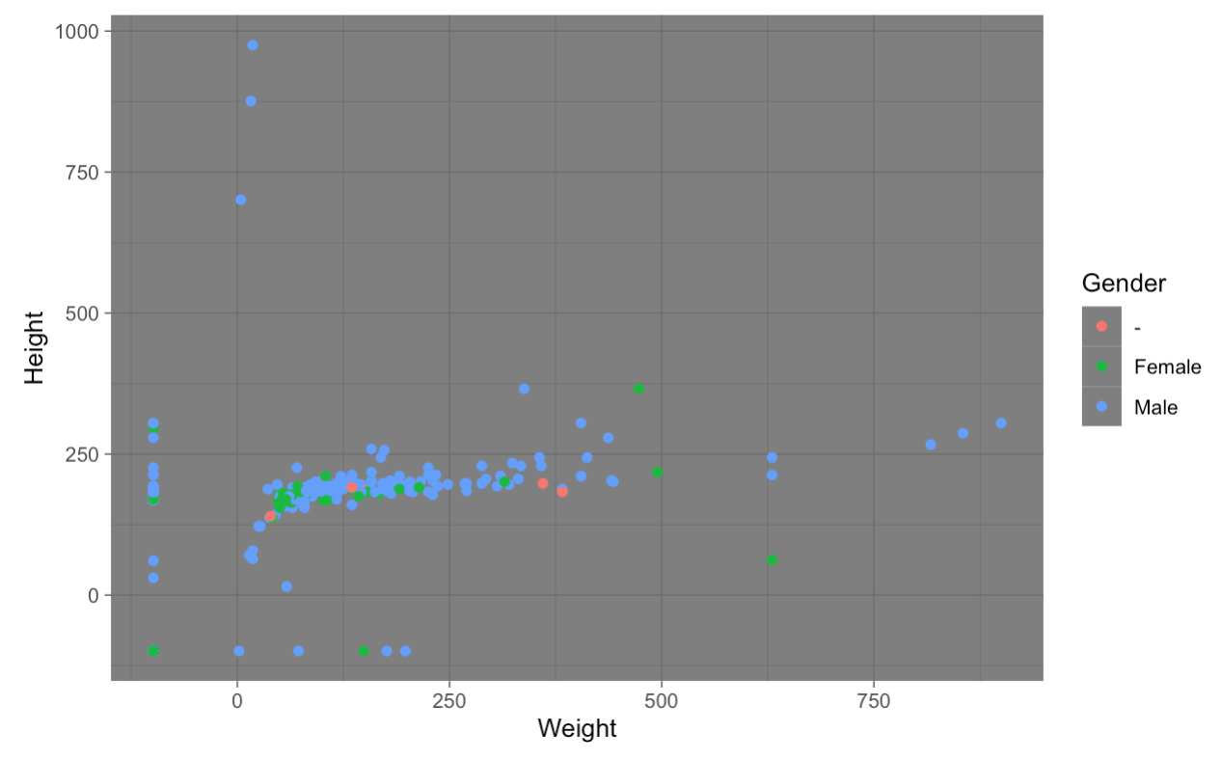
Plotting with ggplot2: themes
ggplot(data = heroes, mapping = aes(Weight,Height))+
geom_point(aes(colour = Gender))+
theme_dark()
Predefined themes that control general style

Slide 54
Plotting with ggplot2: facets
Take data and divides it in multiple panels.
Each panel uses same mapping, scales and so on but splits the data.
Necessary to avoid overplotting when there is too much data

Slide 55
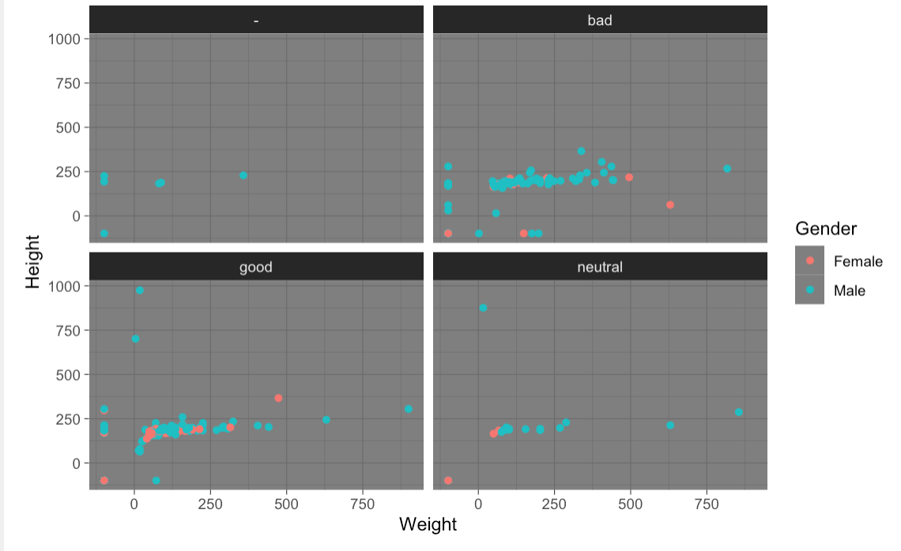
Plotting with ggplot2: facet_wrap
Takes data and splits them using a variable/column from your data to create smaller subplots
ggplot(data = heroes, mapping = aes(Weight,Height))+
geom_point(aes(colour = Gender))+
theme_dark()+
facet_wrap(~Alignment)
Easier to compare!

Slide 56
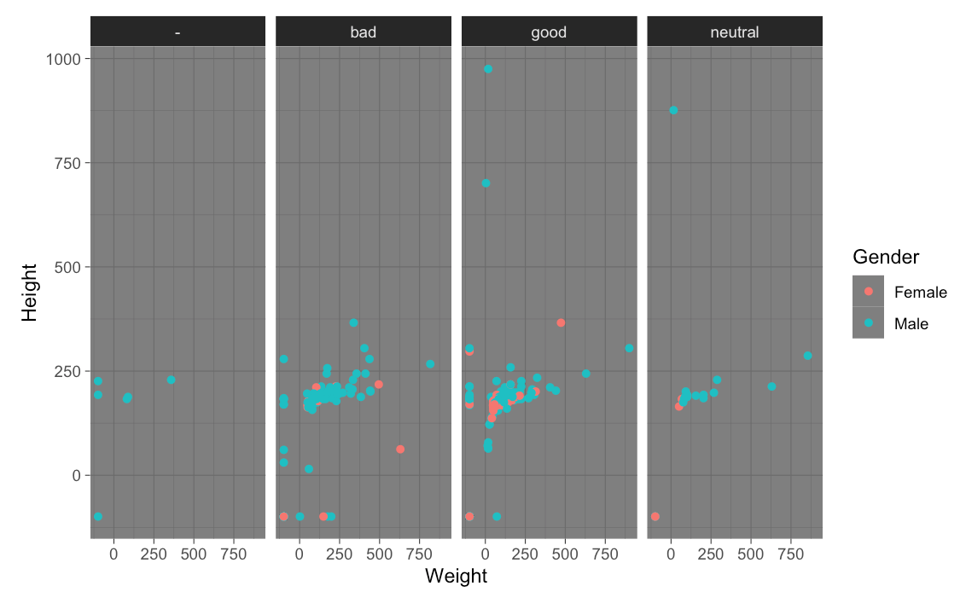
Plotting with ggplot2: facet_grid
Takes data and splits them using a variable/column from your data to create smaller subplots
ggplot(data = heroes, mapping = aes(Weight,Height))+
geom_point(aes(colour = Gender))+
theme_dark()+
facet_grid(~Alignment)

Slide 57
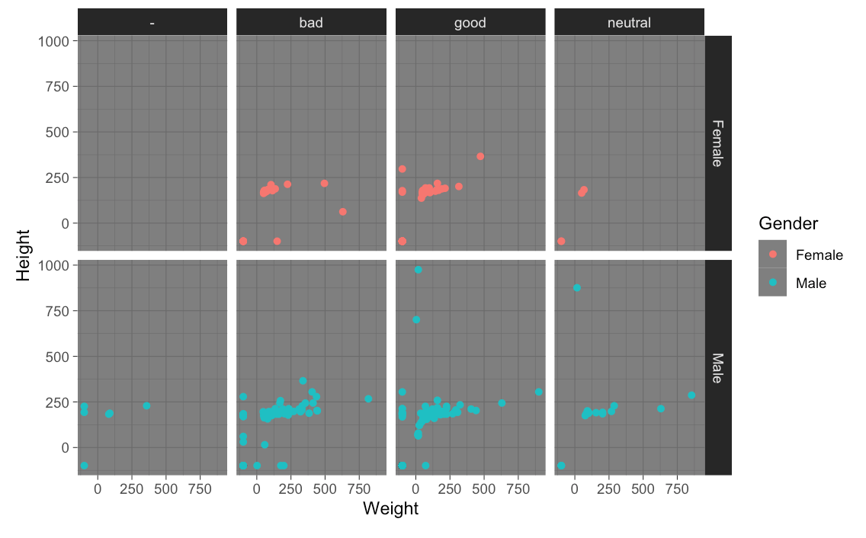
Plotting with ggplot2: facet_grid
Can take 2 variables to create smaller subplots which represent the intersection between the two.
ggplot(data = heroes, mapping = aes(Weight,Height))+
geom_point(aes(colour = Gender))+
theme_dark()+
facet_grid(Gender~Alignment)
Oxford 2023

Slide 58
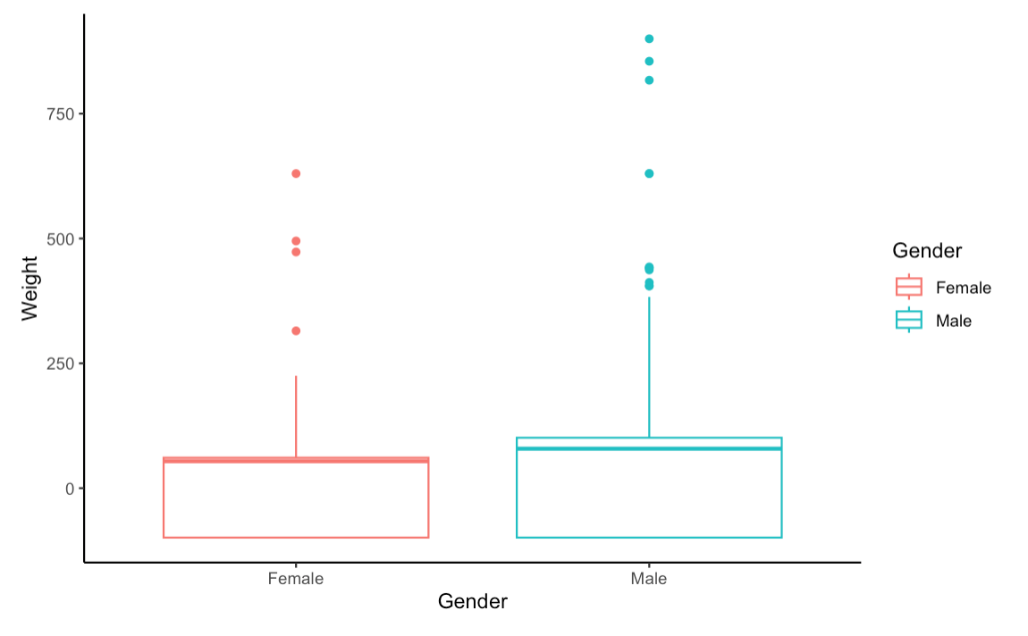
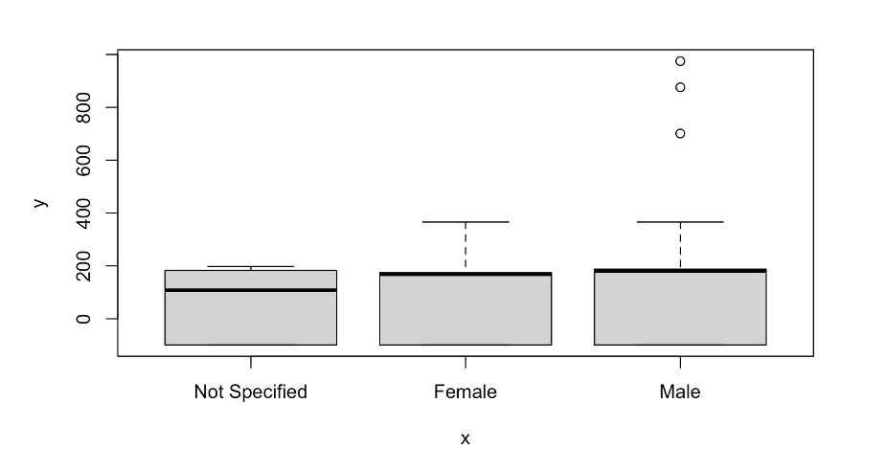
Plotting with ggplot2: boxplots
ggplot(data = heroes, mapping = aes(Gender,Weight)) +
geom_boxplot(aes(colour=Gender)) +
theme_classic()

Slide 59
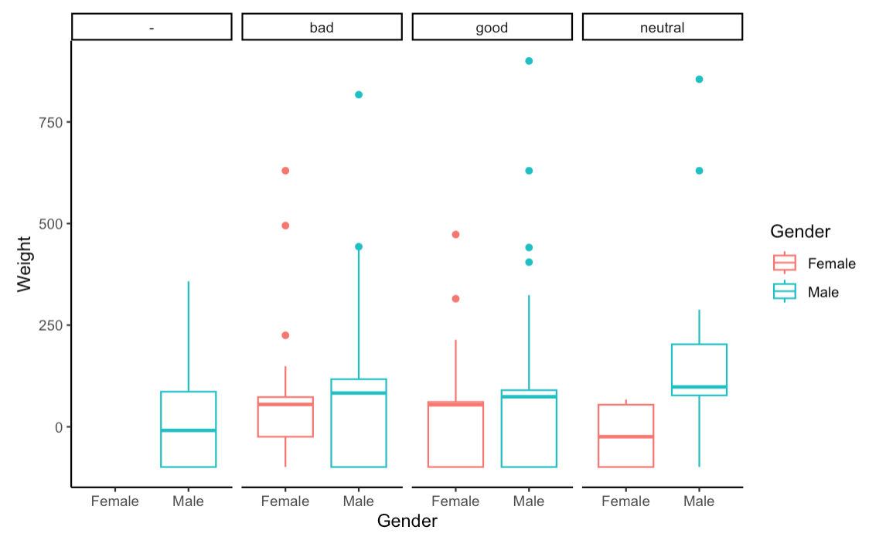
Plotting with ggplot2: facets
ggplot(data = heroes, mapping = aes(Gender,Weight)) +
geom_boxplot(aes(colour=Gender))+
theme_classic()+
facet_grid(~Alignment)

Slide 60
ggplot2: save as a variable/object
myplot = ggplot(data = heroes, mapping = aes(Gender, Weight)) +
geom_boxplot(aes(colour=Gender)) +
theme_classic() +
facet_grid(~Alignment) +
ggtitle (”myplot")
print(myplot)

Slide 61
ggplot2: export using ggsave()
ggsave("myplot.pdf")
ggsave("myplot.png")
ggsave("myplot.pdf", width = 10, height = 5)
ggsave("exported_plot.pdf",
plot = myplot, width = 10, height = 5)

Slide 62
ggplot2: export without ggsave()
Graphs can also be saved writing directly to a graphics device:
pdf("myplot.pdf")
print(myplot)
dev.off()
If working from RScript then we can directly import from the outcome window

Slide 63
Plotting with ggplot2: resources
ggplot2 documentation
https://ggplot2.tidyverse.org/
Data Visualisation chapter in R for Data Science
https://r4ds.had.co.nz/data-visualisation.html
Graphics for communication chapter in R for Data Science
https://r4ds.had.co.nz/graphics-for-communication.html
The R Graph Gallery
https://r-graph-gallery.com/

Slide 64
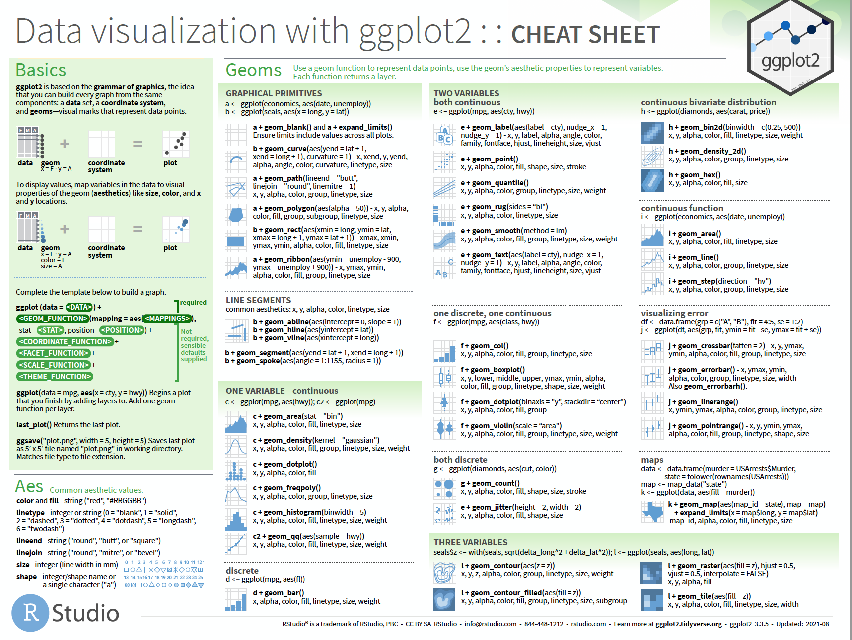
Plotting with ggplot2: resources
https://ggplot2.tidyverse.org

Slide 65
Plotting with ggplot2: ask for help
RStudio community
https://community.rstudio.com/
Stack Overflow
https://stackoverflow.com/questions/tagged/ggplot2?sort=frequent&pageSize=50
Ggplot2 cheat sheet
https://ggplot2.tidyverse.org/
Oxford 2023

Slide 66
Let´s practice!
Image by lucabravo on Freepik

